Slide 1

Debugging

Slide 2
Outline
This is the fifth in a sequence of six topics on
C assertions
Code development strategies
Testing
Commenting your code
Using print statements for debugging
Using the debugger

Slide 3
Outline
In this topic, we will:
Describe the purpose of the debugger
Look at how it is used
Explain some of the benefits

Slide 4
Purpose of debugging
Logging can be frustrating,
as you must insert statements throughout your code
The debugger does all this work for you:
It prepares a different executable: one that tracks all variables
We’ll try this on a program that works
The term debugger tends to scare students
We will start by showing how it works with correct code

Slide 5
Logging with high-low
Here is a program that calculates the gcd of two integers:
#include <iostream>
// Function declarations
int main();
int gcd( int m, int n );
// Function definitions
int main() {
int m{8*3 *7*11*13 *23};
int n{4*9*5 *11 *17*23};
// The gcd should be 4x3x11x23 = 3036
std::cout << gcd( m, n ) << std::endl;
return 0;
}
int gcd( int m, int n ) {
if ( m == 0 ) {
return n;
} else if ( n == 0 ) {
return m;
}
while ( n != 0 ) {
int r{ m%n };
m = n;
n = r;
}
return m;
}

Slide 6

Logging with high-low
In Eclipse (or whichever ide you are using),
you can execute this code in debug mode
Why “bugs”?
The term was used to describe technical issues since the mid 1800s
On September 9th, 1947, operators found an actual bug (a moth) in a computer, and labeled it as “first actual case of bug being found”
RAdm. Grace Hopper popularized the use of “bugs” and “debugging” in computer hardware and software development

Slide 7
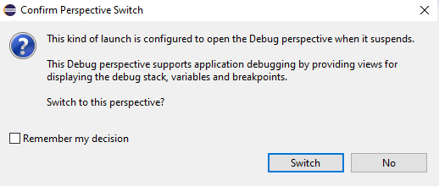
Logging with high-low
When you debug your program, you are asked:
Please do switch

Slide 8
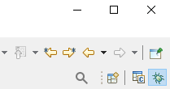
Logging with high-low
For C/C++ development, Eclipse offers two primary perspectives:
C/C++
Debug

Slide 9
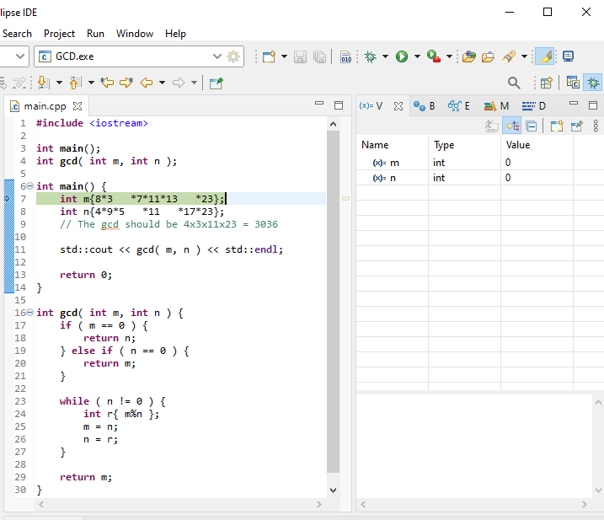
Starting the debugger
The statement to be executed next.
All local variables and parameters,
their types, and their values of the
currently executing function

Slide 10
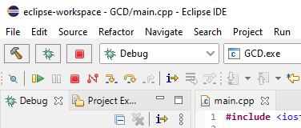
Relevant controls
Stop debugging
Stepping controls

Slide 11
Logging with high-low
Step Return
Step Into
Step Over

Slide 12
Step Into
The Step Into (F5)
Executes the next statement,
unless there is one or more function calls
If there is one or more function calls in the next statement,
step into executing the next function call
Note, it will not step into any function call in the standard library,
only your functions you authored in Eclipse

Slide 13
Step Over
The Step Over (F6)
Executes the next statement
All function calls are made, but you simply see the result
If there are no function calls, Step Over is equivalent to Step Into

Slide 14
Step Return
The Step Return (F6)
Finishes executing the current function and returns to the statement that contains the call to this function
Thus button is inactive when in main()

Slide 15
Stepping through code
The Resume button continues execution until either:
The program finishes
A breakpoint is reached
…and a few other features

Slide 16
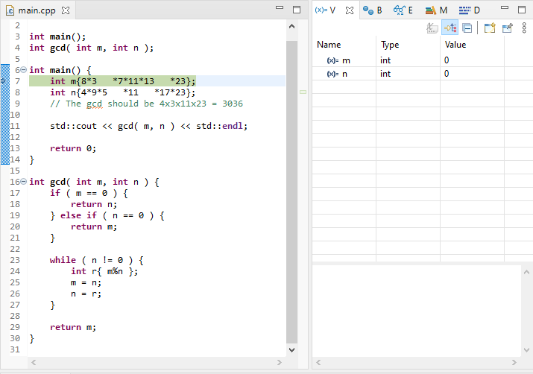
Stepping through code

Slide 17
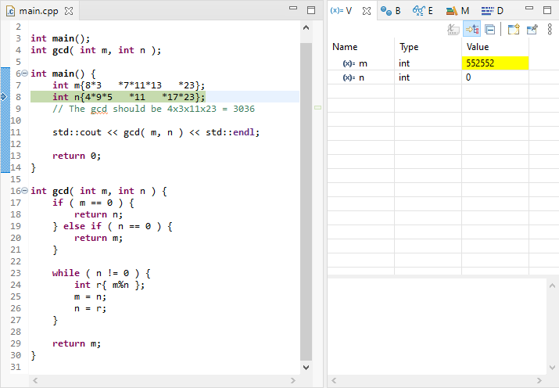
Stepping through code

Slide 18
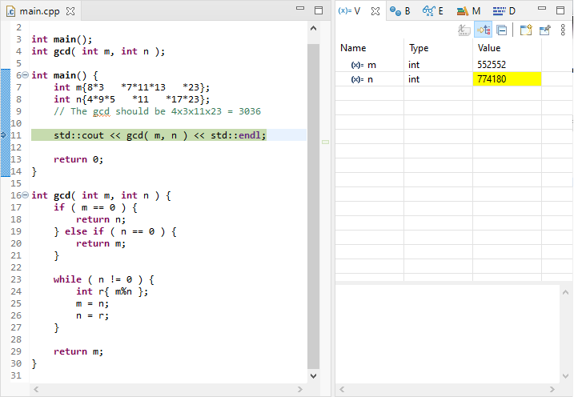
Stepping through code

Slide 19
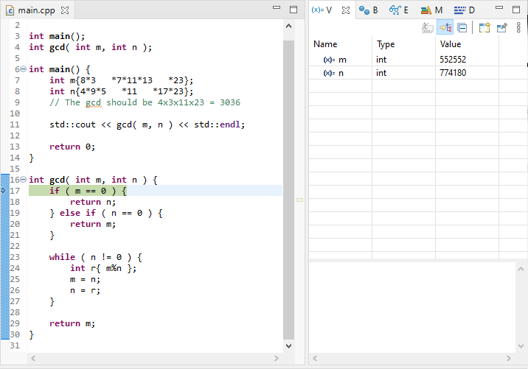
Stepping through code

Slide 20
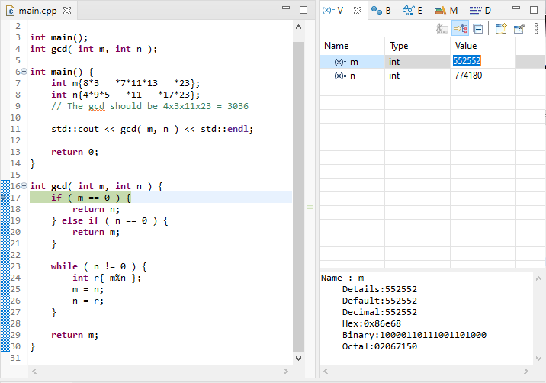
Stepping through code

Slide 21
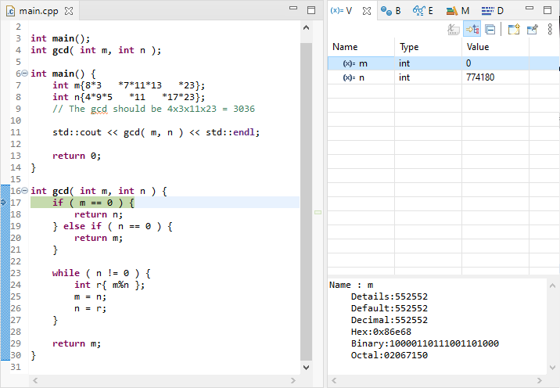
Stepping through code

Slide 22
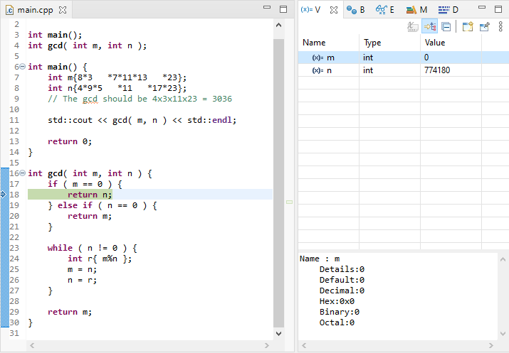
Stepping through code

Slide 23
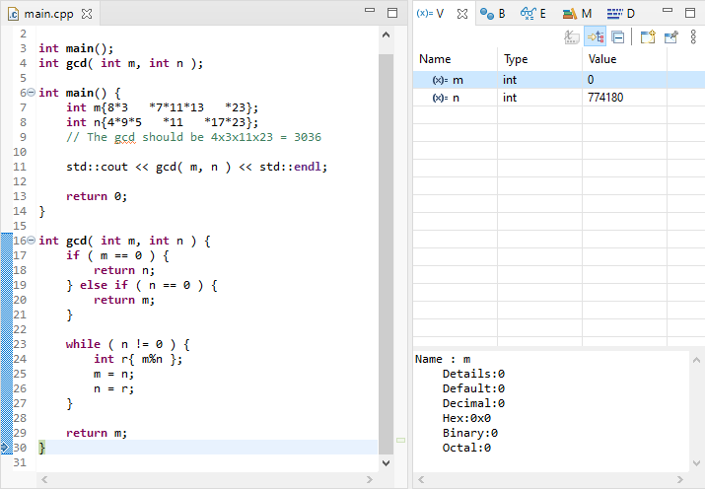
Stepping through code

Slide 24
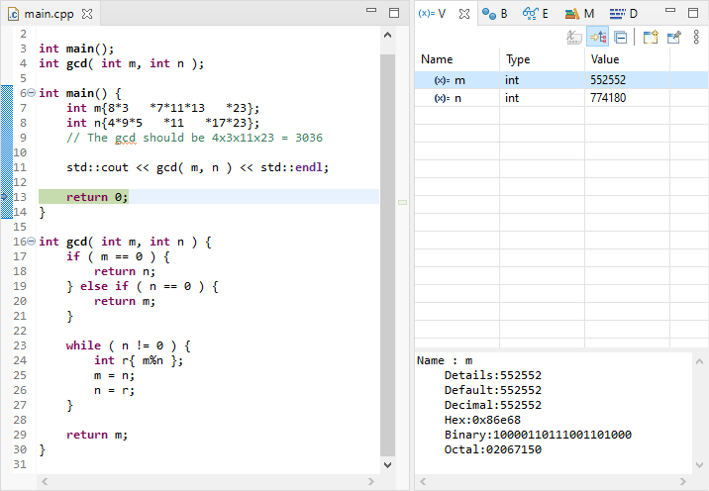
Stepping through code

Slide 25
Breakpoints
At this point, you may have noticed a small weakness
Suppose you have a very large program
Do you really want to step through every statement until you get to the statements where you believe the code may be buggy?
The solution to this are breakpoints
A breakpoint way to indicate to the debugger to stop at a particular statement
Once the debugger stops at a break point,
you can either start stepping through the program
or choose to continue executing
Your program can have multiple breakpoints
You put them where you believe there may be an issue

Slide 26
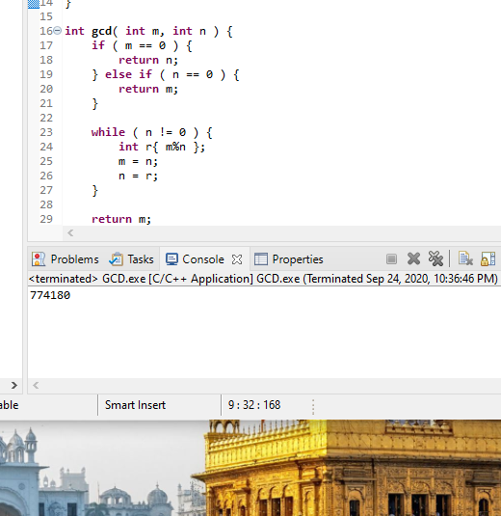
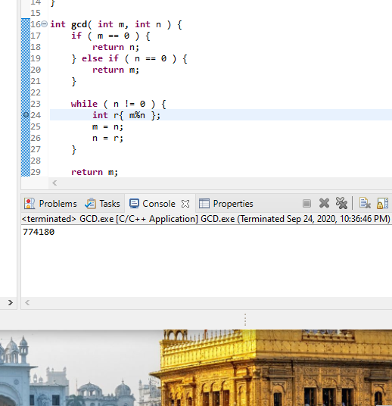
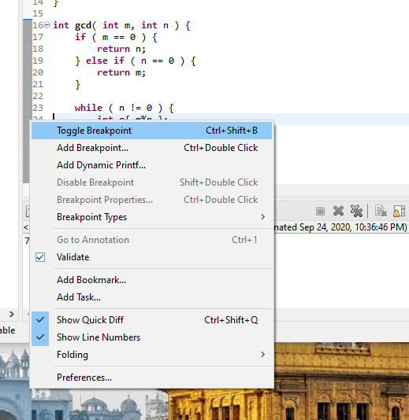
Breakpoints

Slide 27
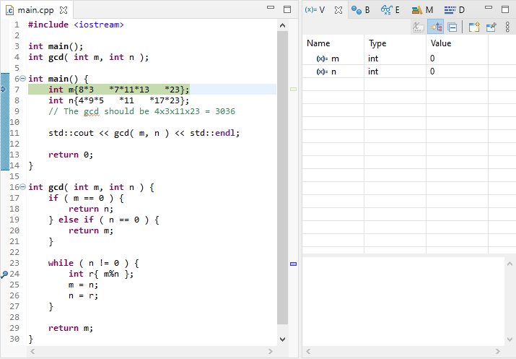
Starting the debugger

Slide 28
Using the debugger
Now you may ask: How do you debug a program?
The debugger simply gives you access to the state of the program while the program is executing
It is easier to become familiar with its functioning with code that works correctly
Try executing the gcd(…) function with smaller arguments,
and watch how it
Later, when you have a program that simply is not working the way you expect, you can switch to the debugger and watch how the state changes
Of course, you must know the expected behavior of the program to discover the problem with your code

Slide 29
Summary
Following this lesson, you now:
Have been introduced to the debugger
Understand all it does is display the values of parameters and local variables
It allows you to execute one statement at a time
Know you can Step Into the execution of functions, or
Step Over the execution of functions and just see the results
Are aware that you can even change the value of parameters and local variables on-the-fly while the debugger is executing
Know you can set break points that allow you to execute the program until the line in question is reached

Slide 30
References
[1] Wikipedia:
https://en.wikipedia.org/wiki/Debugger

Slide 31
Acknowledgments
Sami El-Imam for noting problems in an earlier posting.

Slide 32



Colophon
These slides were prepared using the Georgia typeface. Mathematical equations use Times New Roman, and source code is presented using Consolas.
The photographs of lilacs in bloom appearing on the title slide and accenting the top of each other slide were taken at the Royal Botanical Gardens on May 27, 2018 by Douglas Wilhelm Harder. Please see
https://www.rbg.ca/
for more information.

Slide 33
Disclaimer
These slides are provided for the ece 150 Fundamentals of Programming course taught at the University of Waterloo. The material in it reflects the authors’ best judgment in light of the information available to them at the time of preparation. Any reliance on these course slides by any party for any other purpose are the responsibility of such parties. The authors accept no responsibility for damages, if any, suffered by any party as a result of decisions made or actions based on these course slides for any other purpose than that for which it was intended.

